Slide 1
C programming language

Slide 2
What is Language
Language is a mode of communication that is used to share ideas, opinions with each other. For example, if we want to teach someone, we need a language that is understandable by both communicators.

Slide 3
What is a Programming Language
A programming language is a computer language that is used by programmers (developers) to communicate with computers. It is a set of instructions written in any specific language ( C, C++, Java, Python) to perform a specific task.
A programming language is mainly used to develop desktop applications, websites, and mobile applications.
Example: C, C++, Java, Python, R, C#

Slide 4
Types of programming language
Low-level programming language
Low-level language is machine-dependent (0s and 1s) programming language.
High-level programming language
High-level programming language (HLL) is designed for developing user-friendly software programs and websites. This programming language requires a compiler or interpreter to translate the program into machine language (execute the program).

Slide 5
Middle-level programming language
Middle-level programming language lies between the low-level programming language and high-level programming language. It is also known as the intermediate programming language and pseudo-language.

Slide 6
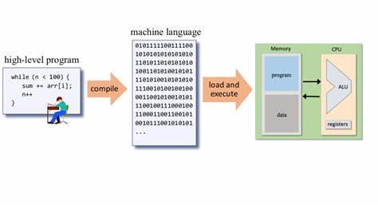
How it works

Slide 7
Compiler
A compiler is a translator that converts the high-level language into the machine language.
High-level language is written by a developer and machine language can be understood by the processor.
Compiler is used to show errors to the programmer.
A compiler converts complete source code into machine code at once. And finally, your program get executes.

Slide 8
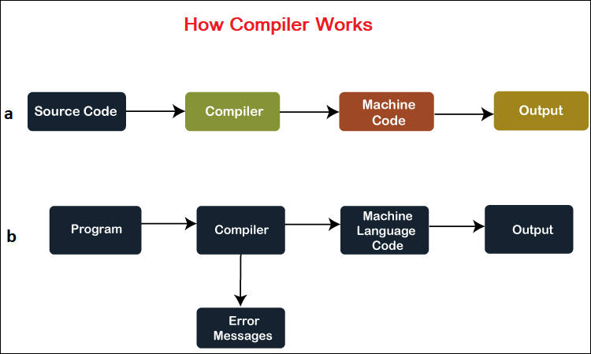

Slide 9
Interpreter
An interpreter is also a software program that translates a source code into a machine language.
However, an interpreter converts high-level programming language into machine language line-by-line while interpreting and running the program.

Slide 10
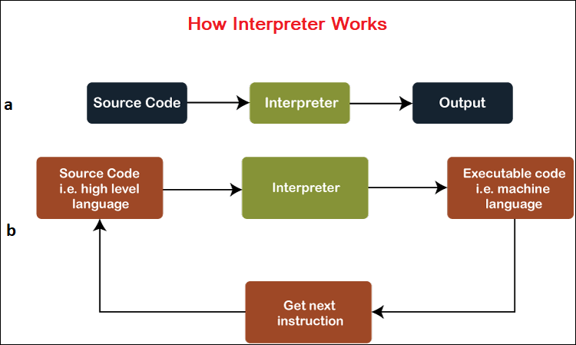

Slide 11

What is C Language
C programming is a general-purpose, procedural, imperative computer programming language.
developed in 1972 by Dennis M. Ritchie at the Bell Telephone Laboratories to develop the UNIX operating system.

Slide 12
Mother language
System programming language
Procedure-oriented programming language
Structured programming language
Mid-level programming language

Slide 13
Advantages of C Language
Efficiency and speed
Portable
Close to Hardware
Standard Libraries
Structured Programming
Procedural Language
Versatility

Slide 14
Drawbacks of C Language
Manual Memory Management
No Object−Oriented Feature
No Garbage Collection
No Exception Handling

Slide 15
Applications of C Language
System Programming
Embedded Systems
Compiler and Interpreters
Database Systems
Networking Software
Game Development
Scientific and Mathematical Applications
Text Editor and IDEs

Slide 16
History of C
Language | Year | Developed By
Algol | 1960 | International Group
BCPL | 1967 | Martin Richard
B | 1970 | Ken Thompson
Traditional C | 1972 | Dennis Ritchie
K & R C | 1978 | Kernighan & Dennis Ritchie
ANSI C | 1989 | ANSI Committee
ANSI/ISO C | 1990 | ISO Committee
C99 | 1999 | Standardization Committee

Slide 17
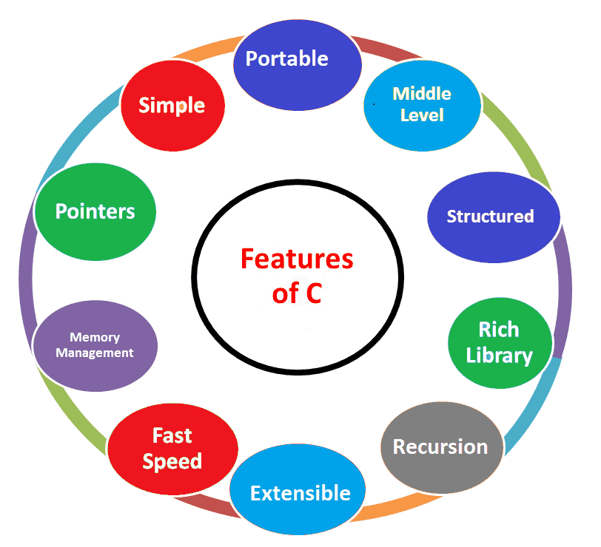
Feature of C

Slide 18
Variables in C
A variable is the name of the memory location. It is used to store information. Its value can be altered and reused several times.
Syntax
data_type variable_name= value;
Example
Int number=15;

Slide 19
Datatypes in C
Data Types or Types are attributes that are predefined or can be created by the user so that the program can easily detect the different types of information.
Data type is used so that the compiler or interpreter of a programming language can be told about the data which is to be used.
The compiler also allocates the required amount of memory storage as per the data type defined thus saving space.

Slide 20
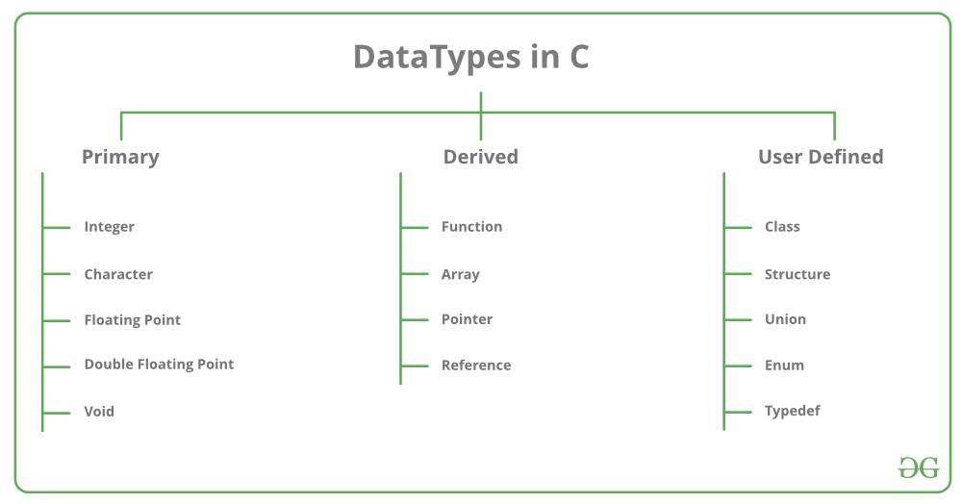

Slide 21
Data Type | Size (bytes) | Range | Format Specifier
int | 4 | -2,147,483,648 to 2,147,483,647 | %d
char | 1 | -128 to 127 | %c
float | 4 | 1.2E-38 to 3.4E+38 | %f
double | 8 | 1.7E-308 to 1.7E+308 | %lf

Slide 22
Syntax
data_type variable_name= value;
Example
Int number=15;
Float speed=4.5;
Char letter=‘e’;

Slide 23
Keywords in C
Keywords in C are reserved words that have predefined meanings and are part of the C language syntax.
These keywords cannot be used as variable names, function names, or any other identifiers within the program except for their intended purpose.

Slide 24
auto | double | int | struct
break | else | long | switch
case | enum | register | typedef
char | extern | return | union
continue | for | signed | void
do | if | static | while
default | goto | sizeof | volatile
const | float | short | unsigned

Slide 25
Comments in C
Comments in C language are used to provide information about lines of code. It is widely used for documenting code.
Single Line Comments //
Multi-Line Comments /*….*/

Slide 26
Escape Sequence | Meaning
\a | Alarm or Beep
\b | Backspace
\f | Form Feed
\n | New Line
\r | Carriage Return
\t | Tab (Horizontal)
\v | Vertical Tab
\\ | Backslash
\' | Single Quote
\" | Double Quote
\? | Question Mark

